Slide 1
Loftware Cloud: Custom Identity Provider Configuration
Customer Information
July 2025

Slide 2
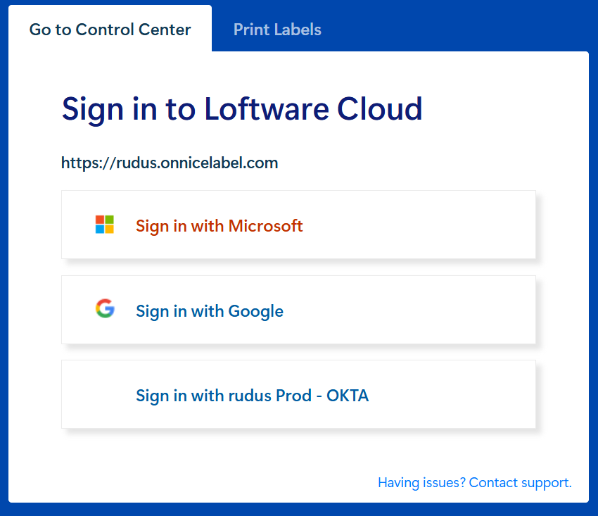
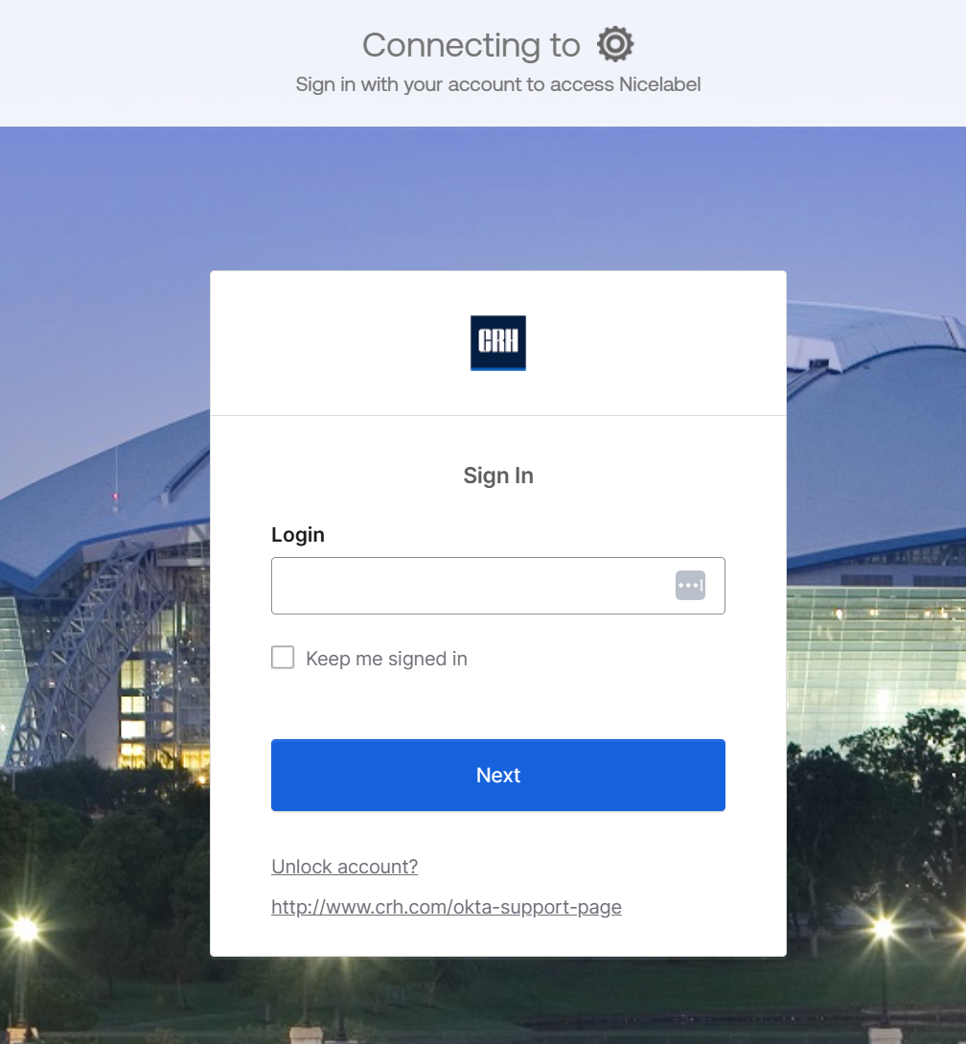
What is a Custom Identity Provider?
Loftware Cloud integrates with OIDC ‘Identity Providers’
  Enables Single Sign On (SSO) using the customer’s corporate authorization and authentication platform
Out of the box Loftware Cloud supports:
  Microsoft Entra ID (formerly Azure Active Directory (AAD))
    Also supports Office 365 and personal Microsoft accounts
  Google
  These can be configured by the customer without assistance from Loftware
    See Loftware Cloud on-line help for more information
Other providers are supported but require specific setup involving Loftware
  These are 'Custom Identity Providers'
  E.g. OKTA, Ping, specific configurations of Entra

Slide 3
Restrictions, Limitations and Caveats
SAML is not supported
PKCE is not currently supported
  Authorization code flow pattern is used
Assignment by groups is not supported
‘Refresh Tokens’ must be enabled
All users required to use the new identity provider will need to be re-invited and must complete the signup process to gain access via the new provider
By default the Loftware Cloud login page will still display the Microsoft and Google logos
  Can be disabled by Loftware but has implications for access, for example by Loftware in a support scenario.
  The new login button for the custom provider can have custom text and logo but:
    The customer must provide a public URL for the logo
    The customer must provide the exact the #HEX code for any specific background colour.
Electronic (digital) signature for Workflows is not supported by default – it can be requested

Slide 4
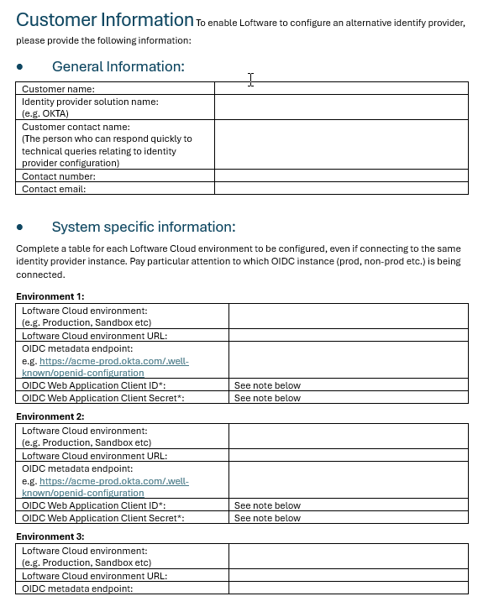
How do we set up a Custom Identity Provider for a customer?
Loftware Cloud_Custom Identity Provider Configuration Customer Information Q3 2025.docx
Integrating with a ‘Custom Identity Provider’ requires:
  A PO for a four (4) hour Professional Services engagement per environment
    i.e. 4 hours for sandbox, 4 hours for production etc.
  Information from the customer about their environment (customer completes the information gathering document (on the right) and see slide 5 for the explanation)
  Access to subject matter expert at the customer to ensure smooth implementation
  Co-ordination with Sales, SA or Loftware Support to arrange a suitable time for Cloud Ops to make the changes

Slide 5
What do we need from the Customer?
Loftware Cloud_Custom Identity Provider Configuration Customer Information Q3 2025.docx
Customer must complete the Loftware Cloud_Custom Identity Provider Configuration Customer Information Q3 2025.docx
Technical contact details
  Must have knowledge of and access to necessary systems and information at the customer
Identity provider solution name
For each specific environment to be connected the following critical information is needed:
  OIDC metadata endpoint (e.g. https://yourcompany.okta.com/.well-known/openid-configuration)
  OIDC Web application client ID
  Associated client secret*
This information must be separated for each environment, even if they use the same Identity Provider instance
NB: Loftware provides a questionnaire for gathering the required details
*Customer is encouraged to use a secure method to send this information

Slide 6
Additional Information from the Customer
Having the following information up-front will speed up implementation
  This information will be familiar if the appropriate customer contact is engaged
Claim Mapping (properties returned from requested scopes after implementation):
  FullName – user's full name (first name + last name)
    Example - “name” or “display_name”
  Email – user's email address
    Example - “email” or “http://schemas.xmlsoap.org/ws/2005/05/identity/claims/emailaddress”
  ProviderSpecificId – uniquely identifies the user (i.e. can be a unique number or guid).
    Example - “preferred_username” or other customer/provider specific claim
  IdName – human-friendly user identifier (i.e. UPN). The value of this claim must be unique.
    Example - “preferred_username” or other customer/provider specific claim
For more information on claim mappings see:
https://developer.okta.com/docs/api/openapi/okta-oauth/guides/overview/
https://auth0.com/docs/get-started/apis/scopes/sample-use-cases-scopes-and-claims

Slide 7
What Will Loftware Do?
Verify that all necessary information has been collected
Agree a suitable time slot to make configuration changes in the cloud
  This will be via Technical Support or PS dependent on engagement
  Non-production environment will be implemented first
  Once non-prod has been verified a suitable slot for Production will be arranged
For each environment configured the following will be provided:
  Sign-in redirect URIs (e.g. http://logincp1.onnicelabel.com/customer)
  Sign-out redirect URIs (e.g. https://logincp1.onnicelabel.com/Account/SignedOut?customerId=[EncodedCustomerId])

Slide 8
Additional Information Relating to Identity Providers
Grants types provided by Loftware:
  Authorization Code
  Refresh Token
Scopes enabled by Loftware
  OpenId
  Profile
  Offline_Access
  Email

Slide 9
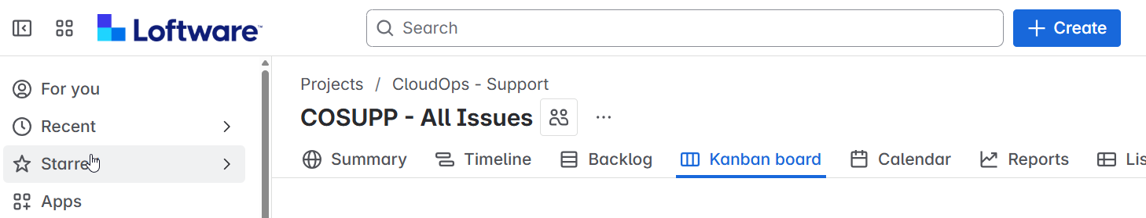
How do I set up a JIRA ticket for Cloud Ops
Log into JIRA at https://nljira.atlassian.net/jira/projects?page=1&sortKey=name&sortOrder=ASC
Select Projects/CloudOps-Support
Create a new ticket: Click on Create
It is a Task I am setting up as the work type
Summary I put in What is being done the customer and the Sales force opportunity this relates to.
Description is where I put in the technical details Cloud Ops need for this task to be completed.
I then can set a Priority level for this.
I then click create for the Ticket to be raised.

Slide 10
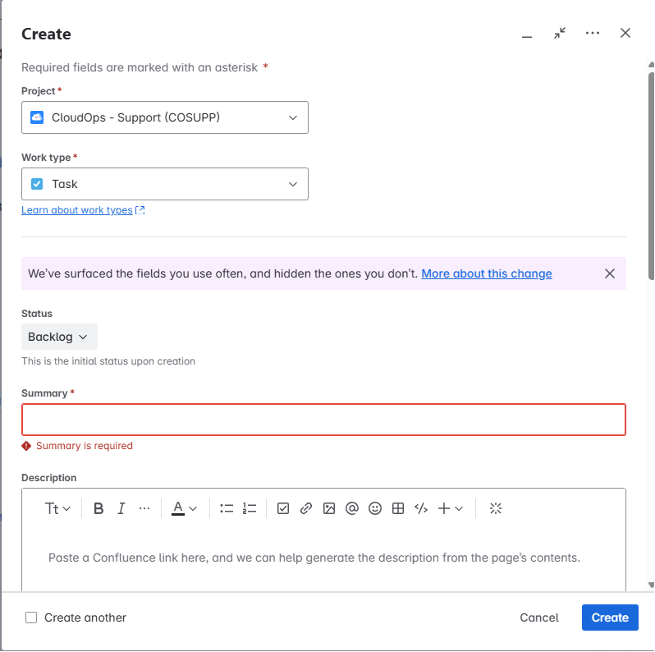
Create the Task for Cloud Ops
Work type: Select Task
Summary: enter customer requirement and the SFDC opportunity
Description: enter the technical details Cloud Ops require and attach the completed questionnaire
Set a Priority level for this task.
Click Create to complete the Ticket

Slide 11
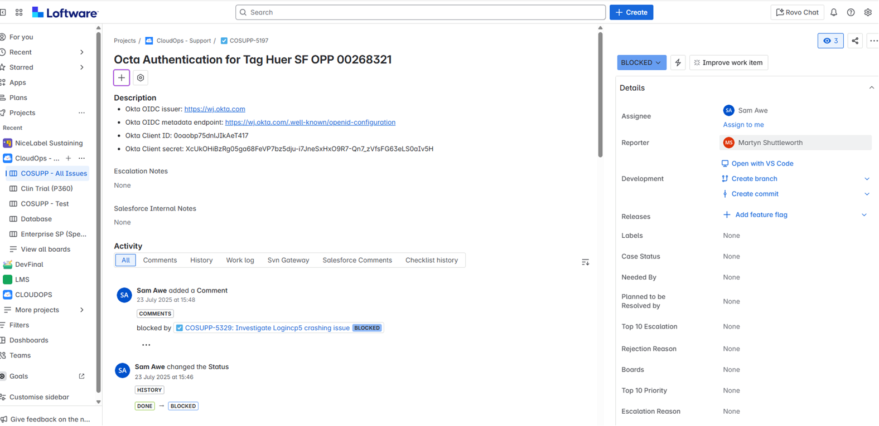
Example JIRA ticket requesting Cloud Ops to set up OKTA

Slide 12
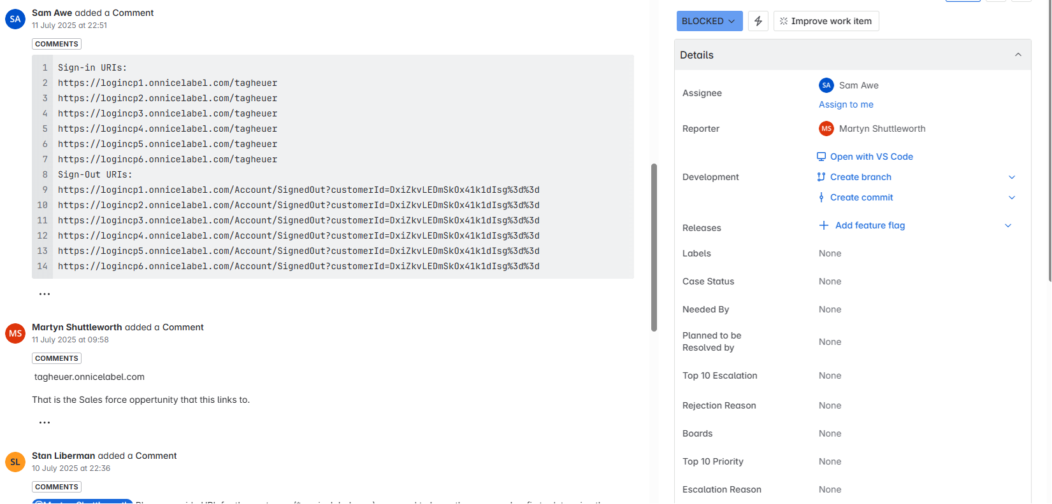
CIPD Information provided by a customer and entered into the JIRA ticket

